Slide 1
DIET #2 Switch Analysis
Updated 08/10/2019

Slide 2
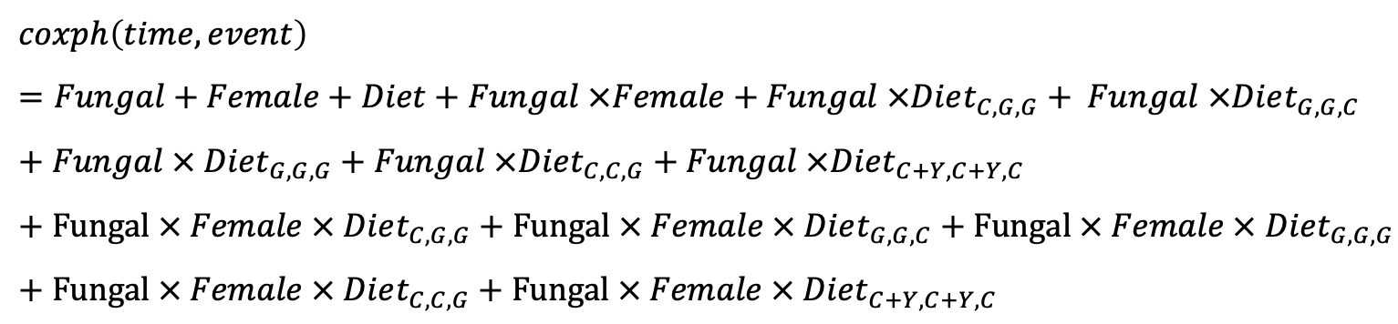
Part I: Cox Model – Formula
$$coxph\left(time, event\right)=Fungal+Female+Diet+Fungal ×Female+Fungal ×Diet_{C,G,G}+ Fungal ×Diet_{G,G,C}+Fungal × Diet_{G,G,G}+Fungal ×Diet_{C,C,G}+Fungal ×Diet_{C+Y,C+Y,C}+Fungal × Female × Diet_{C,G,G}+Fungal × Female × Diet_{G,G,C}+Fungal × Female × Diet_{G,G,G}+Fungal × Female × Diet_{C,C,G}+Fungal × Female × Diet_{C+Y,C+Y,C}$$

Slide 3
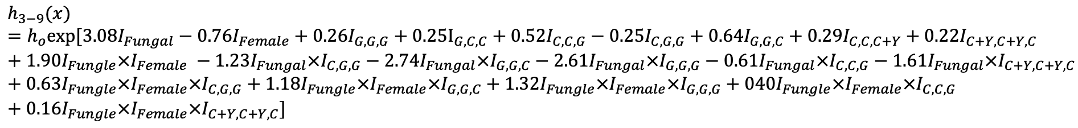
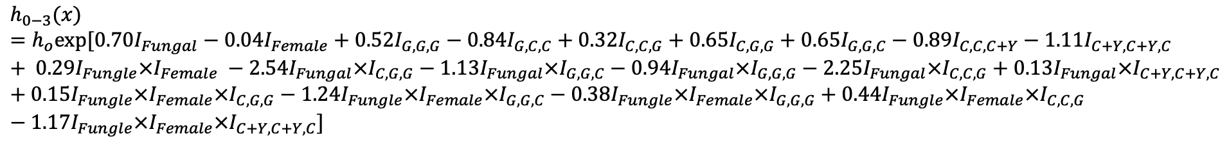
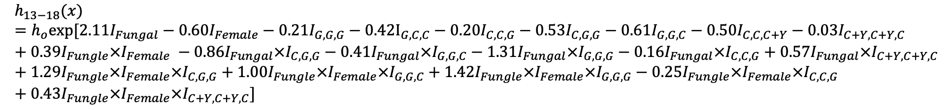
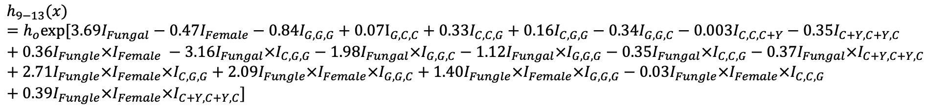
Part I: Cox Model – Coefficients
$$h_{0−3}(x)=h_{o}exp⁡[0.70I_{Fungal}−0.04I_{Female}+0.52I_{G,G,G}−0.84I_{G,C,C}+{0.32I}_{C,C,G}+{0.65I}_{C,G,G}+0.65{I_{G,G,C}−0.89I}_{C,C,C+Y}−1.11I_{C+Y,C+Y,C}+ 0.29I_{Fungle}×I_{Female} −2.54I_{Fungal}×I_{C,G,G}−1.13I_{Fungal}×I_{G,G,C}−0.94I_{Fungal}×I_{G,G,G}−2.25I_{Fungal}×I_{C,C,G}+0.13I_{Fungal}×I_{C+Y,C+Y,C}+0.15I_{Fungle}×I_{Female}×I_{C,G,G}−1.24I_{Fungle}×I_{Female}×I_{G,G,C}−0.38I_{Fungle}×I_{Female}×I_{G,G,G}+0.44I_{Fungle}×I_{Female}×I_{C,C,G}−1.17I_{Fungle}×I_{Female}×I_{C+Y,C+Y,C}]$$
$$h_{3−9}(x)=h_{o}exp⁡[{3.08I}_{Fungal}−0.76I_{Female}+{0.26I}_{G,G,G}+0.25I_{G,C,C}+0.52I_{C,C,G}−0.25I_{C,G,G}+0.64I_{G,G,C}+0.29I_{C,C,C+Y}+0.22I_{C+Y,C+Y,C}+{1.90I}_{Fungle}×I_{Female} −1.23I_{Fungal}×I_{C,G,G}−2.74I_{Fungal}×I_{G,G,C}−2.61I_{Fungal}×I_{G,G,G}−0.61I_{Fungal}×I_{C,C,G}−1.61I_{Fungal}×I_{C+Y,C+Y,C}+0.63I_{Fungle}×I_{Female}×I_{C,G,G}+1.18I_{Fungle}×I_{Female}×I_{G,G,C}+1.32I_{Fungle}×I_{Female}×I_{G,G,G}+040I_{Fungle}×I_{Female}×I_{C,C,G}+0.16I_{Fungle}×I_{Female}×I_{C+Y,C+Y,C}]$$
$$h_{9−13}(x)=h_{o}exp⁡[{3.69I}_{Fungal}−0.47I_{Female}−0.84I_{G,G,G}+0.07I_{G,C,C}+0.33I_{C,C,G}+0.16I_{C,G,G}−0.34I_{G,G,C}−0.003I_{C,C,C+Y}−0.35I_{C+Y,C+Y,C}+0.36I_{Fungle}×I_{Female} −3.16I_{Fungal}×I_{C,G,G}−1.98I_{Fungal}×I_{G,G,C}−1.12I_{Fungal}×I_{G,G,G}−0.35I_{Fungal}×I_{C,C,G}−0.37I_{Fungal}×I_{C+Y,C+Y,C}+{2.71I}_{Fungle}×I_{Female}×I_{C,G,G}+2.09I_{Fungle}×I_{Female}×I_{G,G,C}+1.40I_{Fungle}×I_{Female}×I_{G,G,G}−0.03I_{Fungle}×I_{Female}×I_{C,C,G}+0.39I_{Fungle}×I_{Female}×I_{C+Y,C+Y,C}]$$
$$h_{13−18}(x)=h_{o}exp⁡[2.11I_{Fungal}−0.60I_{Female}−0.21I_{G,G,G}−0.42I_{G,C,C}−0.20I_{C,C,G}−0.53I_{C,G,G}−0.61I_{G,G,C}−0.50I_{C,C,C+Y}−0.03I_{C+Y,C+Y,C}+0.39I_{Fungle}×I_{Female} −0.86I_{Fungal}×I_{C,G,G}−0.41I_{Fungal}×I_{G,G,C}−1.31I_{Fungal}×I_{G,G,G}−0.16I_{Fungal}×I_{C,C,G}+0.57I_{Fungal}×I_{C+Y,C+Y,C}+{1.29I}_{Fungle}×I_{Female}×I_{C,G,G}+1.00I_{Fungle}×I_{Female}×I_{G,G,C}+1.42I_{Fungle}×I_{Female}×I_{G,G,G}−0.25I_{Fungle}×I_{Female}×I_{C,C,G}+0.43I_{Fungle}×I_{Female}×I_{C+Y,C+Y,C}]$$

Slide 4
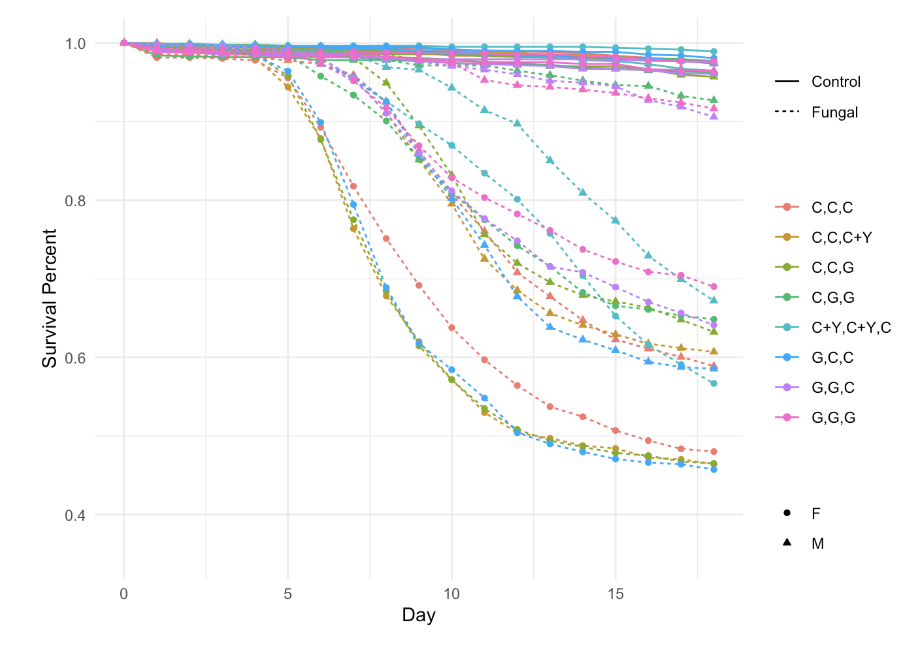
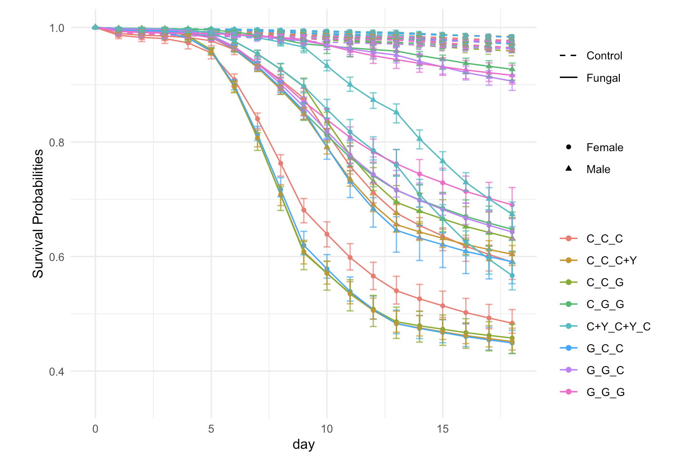
Part I: Cox Model – Survival Plots
Raw data plot
Model plot
Bootstrap: 20

Slide 5
Part II: Analysis Questions

Slide 6
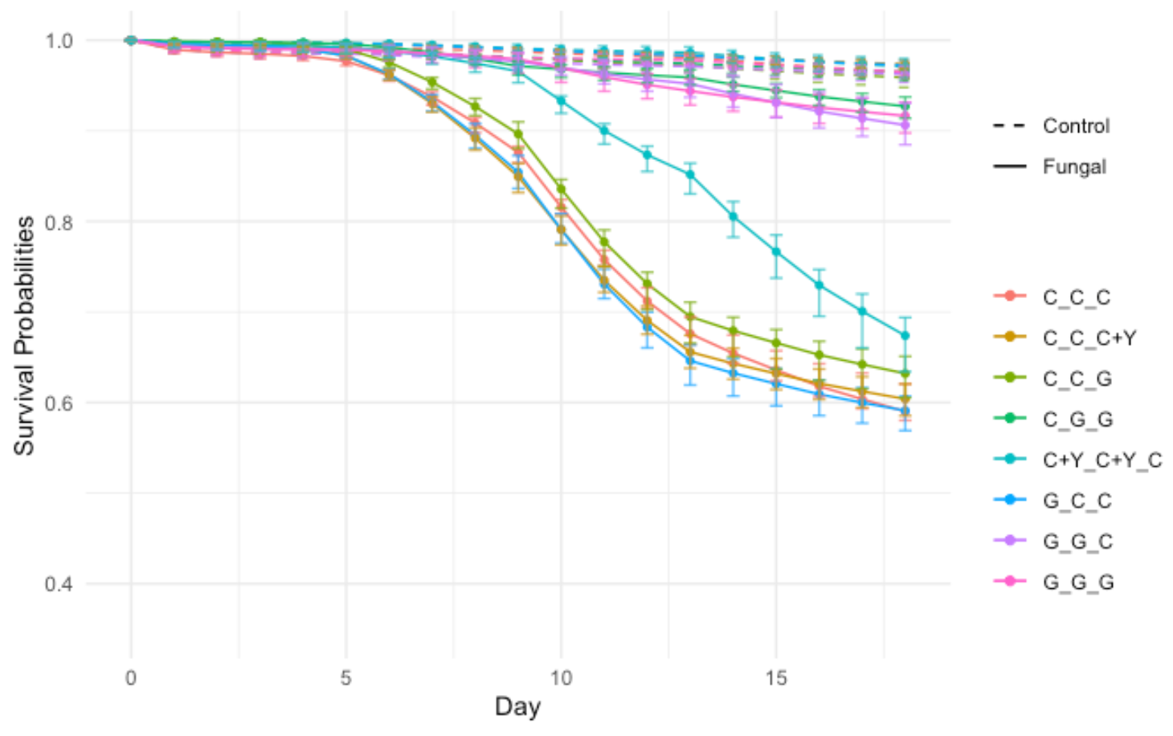
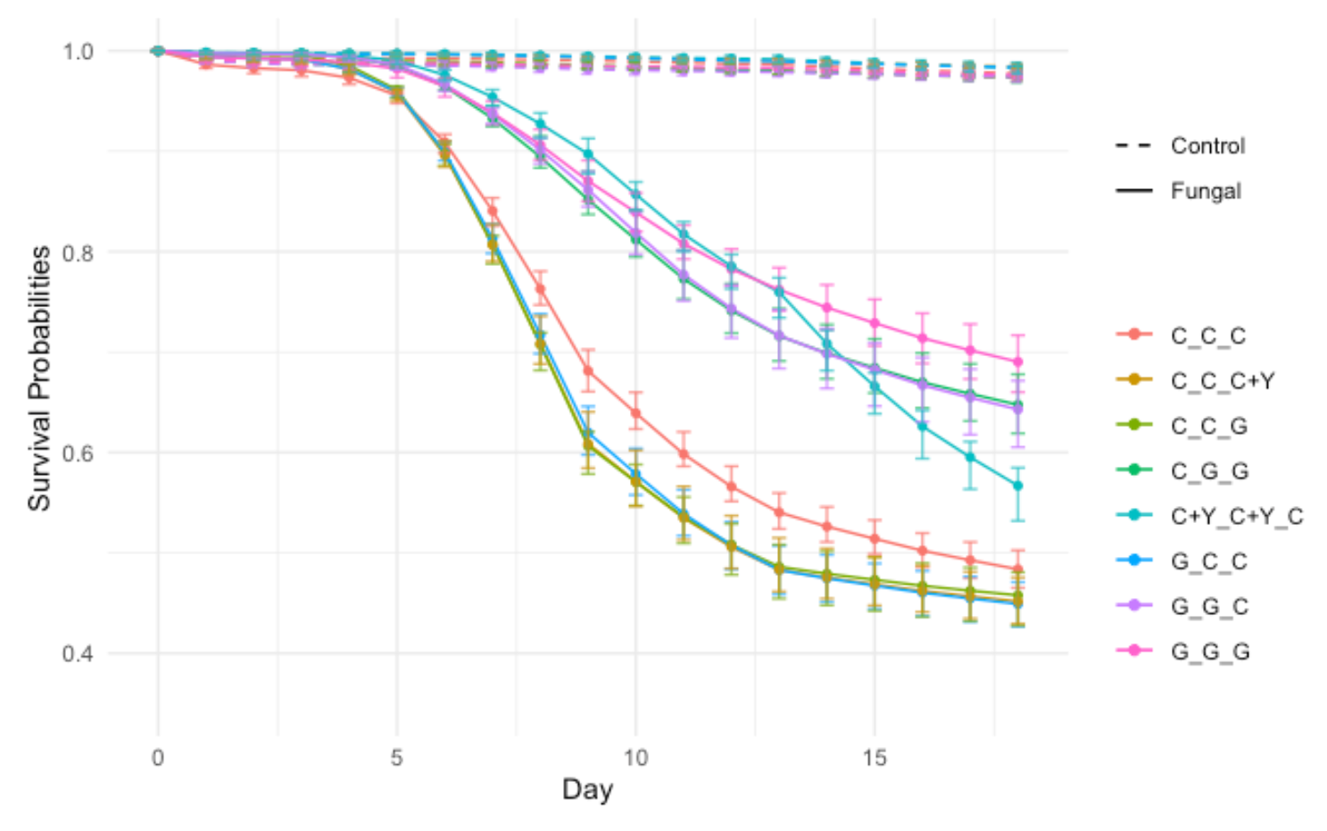
Question 1: Male vs Female
Male
Female

Slide 7
Question 1: Male vs Female
Male
Treatment | Sex | Hazard ratios between diet | 0 – 3 | 3 – 9 | 9 – 13 | 13– 18
Control | Male | C,C,C (baseline) | 1 | 1 | 1 | 1
Control | Male | C,C,G (p-value) | 1.382 (0.3385) | 1.690 (0.1565) | 1.392 (0.3475) | 0.820 (0.4940)
Control | Male | G,C,C (p-value) | 0.434 (0.0034) | 1.290 (0.0005) | 1.077 (0.3616) | 0.656 (0.0022)
Control | Male | C,G,G (p-value) | 1.907 (0.0420) | 0.782 (0.6200) | 1.178 (0.6614) | 0.587 (0.1088)
Control | Male | G,G,C (p-value) | 1.920 (0.0399) | 1.893 (0.0772) | 0.715 (0.4619) | 0.543 (0.0767)
Control | Male | G,G,G (p-value) | 1.674 (0.1065) | 1.292 (0.5171) | 0.433 (0.1232) | 0.808 (0.4530)
Control | Male | C,C,C+Y (p-value) | 0.410 (0.0027) | 1.341 (8.54e-05) | 0.997 (0.9713) | 0.607 (0.0005)
Control | Male | C+Y,C+Y,C (p-value) | 0.331 (0.0483) | 1.242 (0.5986) | 0.702 (0.4383) | 0.973 (0.921)
Treatment | Sex | Hazard ratios between diet | 0 – 3 | 3 – 9 | 9 – 13 | 13– 18
Fungal | Male | C,C,C (baseline) | 1 | 1 | 1 | 1
Fungal | Male | C,C,G (p-value) | 0.146 (0.0115) | 0.915 (0.4800) | 0.982 (0.8579) | 0.697 (0.0329)
Fungal | Male | G,C,C (p-value) | 0.434 (0.0034) | 1.290 (0.0005) | 1.077 (0.3616) | 0.656 (0.0022)
Fungal | Male | C,G,G (p-value) | 0.151 (0.0129) | 0.229 (2.585e-09) | 0.050 (3.553e-15) | 0.249 (6.511e-09)
Fungal | Male | G,G,C (p-value) | 0.623 (0.2659) | 0.123 (5.393e-10) | 0.099 (4.441e-16) | 0.361 (6.984e-07)
Fungal | Male | G,G,G (p-value) | 0.656 (0.3004) | 0.095 (2.307e-10) | 0.141 (<0.0001) | 0.217 (1.494e-09)
Fungal | Male | C,C,C+Y (p-value) | 0.410 (0.0027) | 1.341 (8.54e-05) | 0.997 (0.9713) | 0.607 (0.0005)
Fungal | Male | C+Y,C+Y,C (p-value) | 0.378 (1.494e-09) | 0.249 (5.098e-09) | 0.484 (3.392e-08) | 1.726 (5.599e-05)

Slide 8
Question 1: Male vs Female
Female
Treatment | Sex | Hazard ratios between diet | 0 – 3 | 3 – 9 | 9 – 13 | 13– 18
Control | Female | C,C,C (baseline) | 1 | 1 | 1 | 1
Control | Female | C,C,G (p-value) | 1.382 (0.3385) | 1.690 (0.1565) | 1.392 (0.3475) | 0.820 (0.4940)
Control | Female | G,C,C (p-value) | 0.434 (0.0034) | 1.290 (0.0005) | 1.077 (0.3616) | 0.656 (0.0022)
Control | Female | C,G,G (p-value) | 1.907 (0.0420) | 0.782 (0.6200) | 1.178 (0.6614) | 0.587 (0.1088)
Control | Female | G,G,C (p-value) | 1.920 (0.0399) | 1.893 (0.0772) | 0.715 (0.4619) | 0.543 (0.0767)
Control | Female | G,G,G (p-value) | 1.674 (0.1065) | 1.292 (0.5171) | 0.433 (0.1232) | 0.808 (0.4530)
Control | Female | C,C,C+Y (p-value) | 0.410 (0.0027) | 1.341 (8.54e-05) | 0.997 (0.9713) | 0.607 (0.0005)
Control | Female | C+Y,C+Y,C (p-value) | 0.331 (0.0483) | 1.242 (0.5986) | 0.702 (0.4383) | 0.973 (0.921)
Treatment | Sex | Hazard ratios between diet | 0 – 3 | 3 – 9 | 9 – 13 | 13– 18
Fungal | Female | C,C,C (baseline) | 1 | 1 | 1 | 1
Fungal | Female | C,C,G (p-value) | 0.226 (0.0075) | 1.361 (0.0002) | 0.954 (0.6921) | 0.544 (0.0090)
Fungal | Female | G,C,C (p-value) | 0.434 (0.0034) | 1.290 (0.0005) | 1.077 (0.3616) | 0.656 (0.0022)
Fungal | Female | C,G,G (p-value) | 0.175 (0.0034) | 0.431 (7.496e-12) | 0.750 (0.0149) | 0.907 (0.5759)
Fungal | Female | G,G,C (p-value) | 0.180 (0.0065) | 0.400 (1.037e-12) | 0.795 (0.0486) | 0.980 (0.9048)
Fungal | Female | G,G,G (p-value) | 0.450 (0.0553) | 0.357 (1.8652e-14) | 0.573 (2.1717e-05) | 0.894 (0.5093)
Fungal | Female | C,C,C+Y (p-value) | 0.410 (0.0027) | 1.341 (8.54e-05) | 0.997 (0.9713) | 0.607 (0.0005)
Fungal | Female | C+Y,C+Y,C (p-value) | 0.116 (0.0046) | 0.292 (4.441e-16) | 0.718 (0.0051) | 2.645 (6.719e-10)

Slide 9
Question 2: Glucose (GGG) vs Cornmeal (CCC)
Male
Treatment | Sex | Hazard ratios between diet | 0 – 3 | 3 – 9 | 9 – 13 | 13– 18
Control | Male | C,C,C vs G,G,G (p-value) | 1.674 (0.1065) | 1.292 (0.5171) | 0.433 (0.1232) | 0.808 (0.4530)
Fungal | Male | C,C,C vs G,G,G (p-value) | 0.656 (0.3004) | 0.095 (2.307e-10) | 0.141 (<0.0001) | 0.217 (1.494e-09)
Baseline: CCC
Notes:
Fungal GGG survived better than fungal CCC from 3-18.
No difference between 0-3.

Slide 10
Question 2: Glucose (GGG) vs Cornmeal (CCC)
Female
Treatment | Sex | Hazard ratios between diet | 0 – 3 | 3 – 9 | 9 – 13 | 13– 18
Control | Female | C,C,C vs G,G,G (p-value) | 1.674 (0.1065) | 1.292 (0.5171) | 0.433 (0.1232) | 0.808 (0.4530)
Fungal | Female | C,C,C vs G,G,G (p-value) | 0.450 (0.0553) | 0.357 (1.8652e-14) | 0.573 (2.1717e-05) | 0.894 (0.5093)
Baseline: CCC
Notes:
Fungal GGG survived better than fungal CCC from 3-13.
No difference between either 0-3 or 13-18.

Slide 11
Question 3: Cornmeal Treatments
Male
Treatment | Sex | Hazard ratios between sex | 0 – 3 | 3 – 9 | 9 – 13 | 13– 18
Control | Male | C,C,C vs C,G,G (p-value) | 1.907 (0.0420) | 0.782 (0.6200) | 1.178 (0.6614) | 0.587 (0.1088)
Control | Male | C,C,C vs C,C,G (p-value) | 1.382 (0.3385) | 1.690 (0.1565) | 1.392 (0.3475) | 0.820 (0.4940)
Fungal | Male | C,C,C vs C,G,G (p-value) | 0.151 (0.0129) | 0.229 (2.585e-09) | 0.050 (3.553e-15) | 0.249 (6.511e-09)
Fungal | Male | C,C,C vs C,C,G (p-value) | 0.146 (0.0115) | 0.915 (0.4800) | 0.982 (0.8579) | 0.697 (0.0329)
Baseline: CCC
Notes:
CCC vs CGG (Day 1 post spray)
Fungal CGG survived better than fungal CCC from 0-18.
CCC vs CCG (Day 9 post spray)
Fungal CCG survived better than fungal CCC from 0-3 and 13-18.
No difference between 3-13.

Slide 12
Question 3: Cornmeal Treatments
Female
Treatment | Sex | Hazard ratios between sex | 0 – 3 | 3 – 9 | 9 – 13 | 13– 18
Control | Female | C,C,C vs C,G,G (p-value) | 1.907 (0.0420) | 0.782 (0.6200) | 1.178 (0.6614) | 0.587 (0.1088)
Control | Female | C,C,C vs C,C,G (p-value) | 1.382 (0.3385) | 1.690 (0.1565) | 1.392 (0.3475) | 0.820 (0.4940)
Fungal | Female | C,C,C vs C,G,G (p-value) | 0.175 (0.0034) | 0.431 (7.496e-12) | 0.750 (0.0149) | 0.907 (0.5759)
Fungal | Female | C,C,C vs C,C,G (p-value) | 0.226 (0.0075) | 1.361 (0.0002) | 0.954 (0.6921) | 0.544 (0.0090)
Baseline: CCC
Notes:
CCC vs CGG (Day 1 post spray)
Fungal CGG survived better than fungal CCC from 0-13.
No difference between 13-18.
CCC vs CCG (Day 9 post spray)
Fungal CCG survived better than fungal CCC from 0-3 and 13-18.
Fungal CCG survived worse than fungal CCC from 3-9.
No difference between 9-13.

Slide 13
Question 4: Glucose Treatments
Male
Treatment | Sex | Hazard ratios between sex | 0 – 3 | 3 – 9 | 9 – 13 | 13– 18
Control | Male | G,G,G vs G,C,C (p-value) | 0.259 (0.0003) | 0.999 (0.9974) | 2.489 (0.0938) | 0.812 (0.4736)
Control | Male | G,G,G vs G,G,C (p-value) | 1.147 (0.6463) | 1.465 (0.3889) | 1.653 (0.4387) | 0.673 (0.3036)
Fungal | Male | G,G,G vs G,C,C (p-value) | 0.661 (0.3492) | 13.527 (5.9941e-12) | 7.626 (<0.0001) | 3.022 (8.0558e-06)
Fungal | Male | G,G,G vs G,G,C (p-value) | 0.951 (0.9175) | 1.286 (0.5588) | 0.698 (0.2048) | 1.666 (0.0498)
Baseline: GGG
Notes:
GGG vs GCC (Day 1 post spray)
Fungal GCC survived worse than fungal GGG from 3-18.
No difference between 0-3.
GGG vs GGC (Day 9 post spray)
Fungal GGC survived worse than fungal GGG from 13-18.
No difference between 0-13.

Slide 14
Question 4: Glucose Treatments
Female
Treatment | Sex | Hazard ratios between sex | 0 – 3 | 3 – 9 | 9 – 13 | 13– 18
Control | Female | G,G,G vs G,C,C (p-value) | 0.259 (0.0003) | 0.999 (0.9974) | 2.489 (0.0938) | 0.812 (0.4736)
Control | Female | G,G,G vs G,G,C (p-value) | 1.147 (0.6463) | 1.465 (0.3889) | 1.653 (0.4387) | 0.673 (0.3036)
Fungal | Female | G,G,G vs G,C,C (p-value) | 0.963 (0.9333) | 3.613 (<0.0001) | 1.878 (1.9974e-06) | 0.733 (0.0895)
Fungal | Female | G,G,G vs G,G,C (p-value) | 0.400 (0.1799) | 1.120 (0.3975) | 1.387 (0.0180) | 1.096 (0.6054)
Baseline: GGG
Notes:
GGG vs GCC (Day 1 post spray)
Fungal GCC survived worse than fungal GGG from 3-13.
No difference between either 0-3 or 13-18.
GGG vs GGC (Day 9 post spray)
Fungal GGC survived worse than fungal GGG from 9-13.
No difference between either 0-9 or 13-18.

Slide 15
Question 5: Yeast vs Glucose
Male
Treatment | Sex | Hazard ratios between sex | 0 – 3 | 3 – 9 | 9 – 13 | 13– 18
Control | Male | C,C,C vs C,C,C+Y (p-value) | 0.410 (0.0027) | 1.341 (8.54e-05) | 0.997 (0.9713) | 0.607 (0.0005)
Control | Male | C,C,C+Y vs C,C,G (p-value) | 3.370 (0.0023) | 1.260 (0.5297) | 1.396 (0.3436) | 1.350 (0.3160)
Control | Male | C+Y,C+Y,C vs G,G,C (p-value) | 5.804 (0.0017) | 1.524 (0.3591) | 1.018 (0.9753) | 0.558 (0.1245)
Fungal | Male | C,C,C vs C,C,C+Y (p-value) | 0.410 (0.0027) | 1.341 (8.54e-05) | 0.997 (0.9713) | 0.607 (0.0005)
Fungal | Male | C,C,C+Y vs C,C,G (p-value) | 0.357 (0.1824) | 0.682 (0.0025) | 0.985 (0.8826) | 1.149 (0.4425)
Fungal | Male | C+Y,C+Y,C vs G,G,C (p-value) | 1.992 (0.2791) | 0.561 (0.3200) | 0.482 (0.2839) | 0.085 (2.6420e-07)
Baselines:
C,C,C
C,C,C+Y
C+Y,C+Y,C
Notes:
CCC vs CCCY
Fungal CCCY survived better than fungal CCC from 0-3 and 13-18.
Fungal CCCY survived worse than fungal CCC from 3-9.
No difference between 9-13.
CCCY == CCG?
Fungal CCG survived better than fungal CCCY from 3-9.
No difference between either 0-3 or 9-18.
CYCYC == GGC?
Fungal GGC survived better than fungal CYCYC from 13-18.
No difference between 0-13.

Slide 16
Question 5: Yeast vs Glucose
Female
Treatment | Sex | Hazard ratios between sex | 0 – 3 | 3 – 9 | 9 – 13 | 13– 18
Control | Female | C,C,C vs C,C,C+Y (p-value) | 0.410 (0.0027) | 1.341 (8.54e-05) | 0.997 (0.9713) | 0.607 (0.0005)
Control | Female | C,C,C+Y vs C,C,G (p-value) | 3.370 (0.0023) | 1.260 (0.5297) | 1.396 (0.3436) | 1.350 (0.3160)
Control | Female | C+Y,C+Y,C vs G,G,C (p-value) | 5.804 (0.0017) | 1.524 (0.3591) | 1.018 (0.9753) | 0.558 (0.1245)
Fungal | Female | C,C,C vs C,C,C+Y (p-value) | 0.410 (0.0027) | 1.341 (8.54e-05) | 0.997 (0.9713) | 0.607 (0.0005)
Fungal | Female | C,C,C+Y vs C,C,G (p-value) | 0.552 (0.3019) | 1.015 (0.8444) | 0.957 (0.7138) | 0.896 (0.6453)
Fungal | Female | C+Y,C+Y,C vs G,G,C (p-value) | 1.545 (0.6352) | 1.371 (0.0284) | 1.107 (0.4283) | 0.370 (2.4842e-09)
Baselines:
C,C,C
C,C,C+Y
C+Y,C+Y,C
Notes:
CCC vs CCCY
Fungal CCCY survived better than fungal CCC from 0-3 and 13-18.
Fungal CCCY survived worse than fungal CCC from 3-9.
No difference between 9-13.
CCCY == CCG?
No difference between 0-18.
CYCYC == GGC?
Fungal GGC survived worse than fungal CYCYC from 3-9.
Fungal GGC survived better than fungal CYCYC from 13-18.
No difference between either 0-3, or 9-13.

Slide 17
Question 6: Timing of Yeast
Male
Treatment | Sex | Hazard ratios between sex | 0 – 3 | 3 – 9 | 9 – 13 | 13– 18
Control | Male | C+Y,C+Y,C vs C,C,C+Y (p-value) | 1.239 (0.7138) | 1.080 (0.8522) | 1.419 (0.4424) | 0.624 (0.0988)
Fungal | Male | C+Y,C+Y,C vs C,C,C+Y (p-value) | 1.086 (0.8781) | 5.381 (8.1943e-12) | 2.059 (4.3395e-08) | 0.352 (3.0765e-10)
Baselines:
C+Y,C+Y,C
Notes:
CYCYC vs CCCY
Fungal CCCY survived worse than fungal CYCYC from 3-18.
No difference between 0-3.

Slide 18
Question 6: Timing of Yeast
Female
Treatment | Sex | Hazard ratios between sex | 0 – 3 | 3 – 9 | 9 – 13 | 13– 18
Control | Female | C+Y,C+Y,C vs C,C,C+Y (p-value) | 1.239 (0.7138) | 1.080 (0.8522) | 1.419 (0.4424) | 0.624 (0.0988)
Fungal | Female | C+Y,C+Y,C vs C,C,C+Y (p-value) | 3.516 (0.1020) | 4.600 (<0.0001) | 1.389 (0.0060) | 0.230 (1.1546e-14)
Baselines:
C+Y,C+Y,C
Notes:
CYCYC vs CCCY
Fungal CCCY survived worse than fungal CYCYC from 3-18.
No difference between 0-3.

